Slide 1


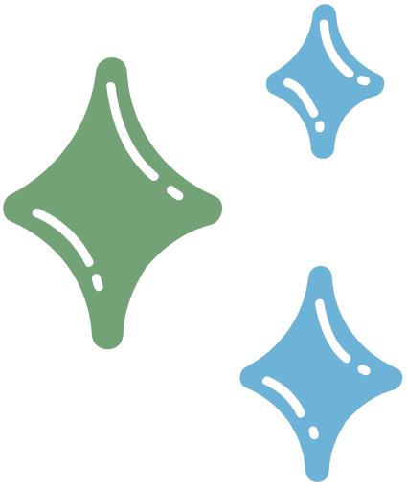

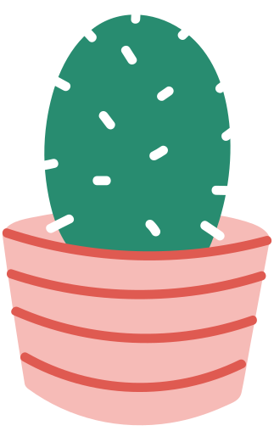
Spur: Med-fi Prototype
Bhavya Shah, Simran Tandon,
Nils Forstall, Hannah Cussen

Slide 2
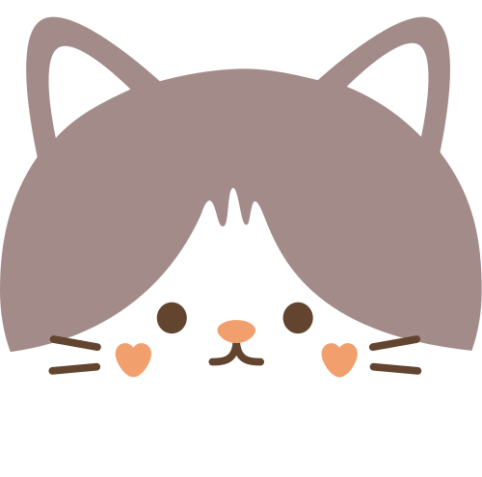
Spur.
Of the moment.
When you're scrolling on your phone, there's always something better to do. We'll help spur you to action!

Slide 3

Spur is for
We solve this by
The time in your day when you're stuck scrolling on your phone, knowing that you should do something different but not knowing exactly what to do.
Thinking of an activity to do can be a drag, and planning one is such a headache. Both of which keep you scrolling and stuck in a rut.
Lowering the activation energy to find and plan an activity.
Browse suggested activities
Get information on details like location, time, and price
See which of your friends are interested in activities and invite them to do one!

Slide 4
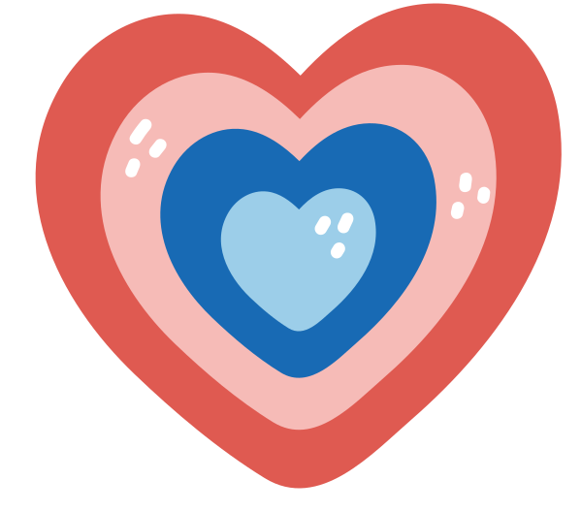

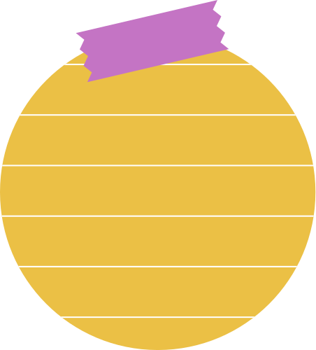
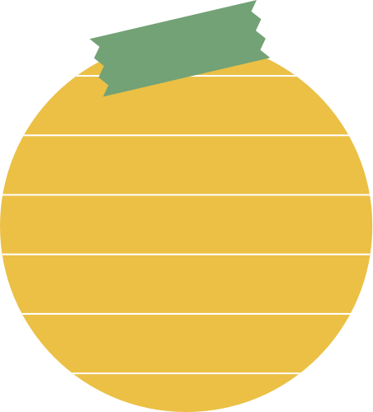
Table Of Contents
01
02
03
Values
Tasks
Usability Goals & Key measurements
04
05
06
Revised Interface sketches
Task Flows
Prototype Implementation

Slide 5



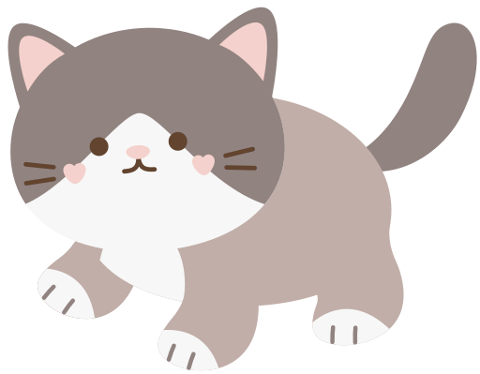

01
Values

Slide 6
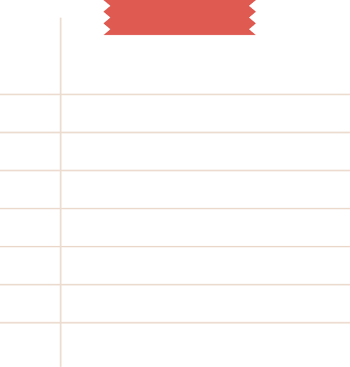
We Intend to Encode
Easy but nonaddictive.
Spur should encourage you to get off your phone, not spend more time on it.
Connection.
Spur should encourage in-person human connection.
Real-life living.
Spur believes time is best spent in the real world.

Slide 7
Features from Values
Easy but nonaddictive.
Swiping mechanic for low activation energy, but no infinite swiping (limited options).
Connection.
Inviting friends to do activities, and showing which friends are interested in the same activities as you.
Real-life living.
Only show activities that don't require a personal screen (i.e. no gaming, video-watching).

Slide 8
Value tensions
Easy but nonaddictive.
Ease of use and addiction are intertwined.
Connection.
Showing someone's interests or when they have free time to other people may invade privacy.
Real-life living.
Should a phone app tell you how to live your life?
We don't think so, we just provide suggestions to get off your phone.

Slide 9




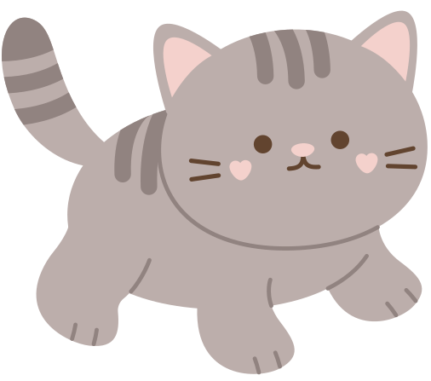
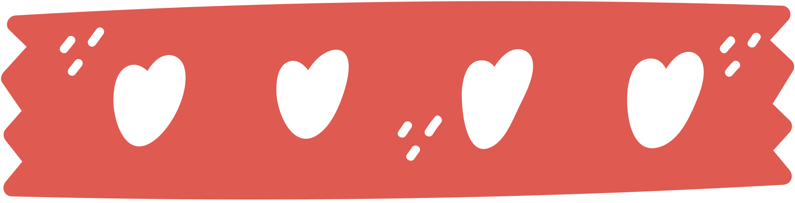
02
Tasks
01

Slide 10

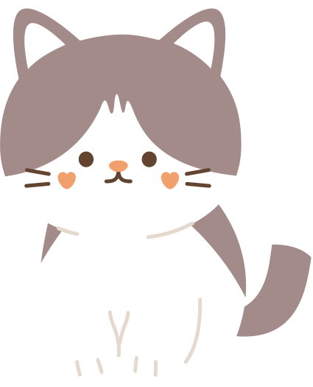
Three tasks
Simple
Medium
Complex
View activities, reject them,
or save them
Get more information on an activity or event.
Coordinate an activity with other people.
Changes from A5?
We considered changing our complex task to "adding a custom activity." That would be a great feature for power users, but in the end it's essentially filling out a form. Since there are many existing form UIs on mobile, we decided to focus on tasks with more interesting UI components.

Slide 11


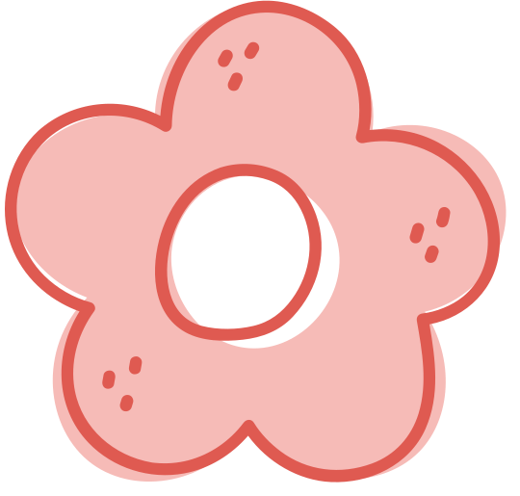
03
Usability goals +
Key measurements
01

Slide 12
Usability Goals
Flexibility.
People should be able to plan activities in the way they see fit, whether that starts with choosing people or an activity.
Intuitive and easy to master.
The interface should explain itself with minimal tutorials.

Slide 13
Key Measurements
Flexibility.
Able to plan an activity starting with their desired criteria
Intuitive and easy to master.
Able to complete a task with fewer than 4 misclicks
Don’t get totally stuck at any point (>20s)

Slide 14
04
Revised interface Sketches

Slide 15
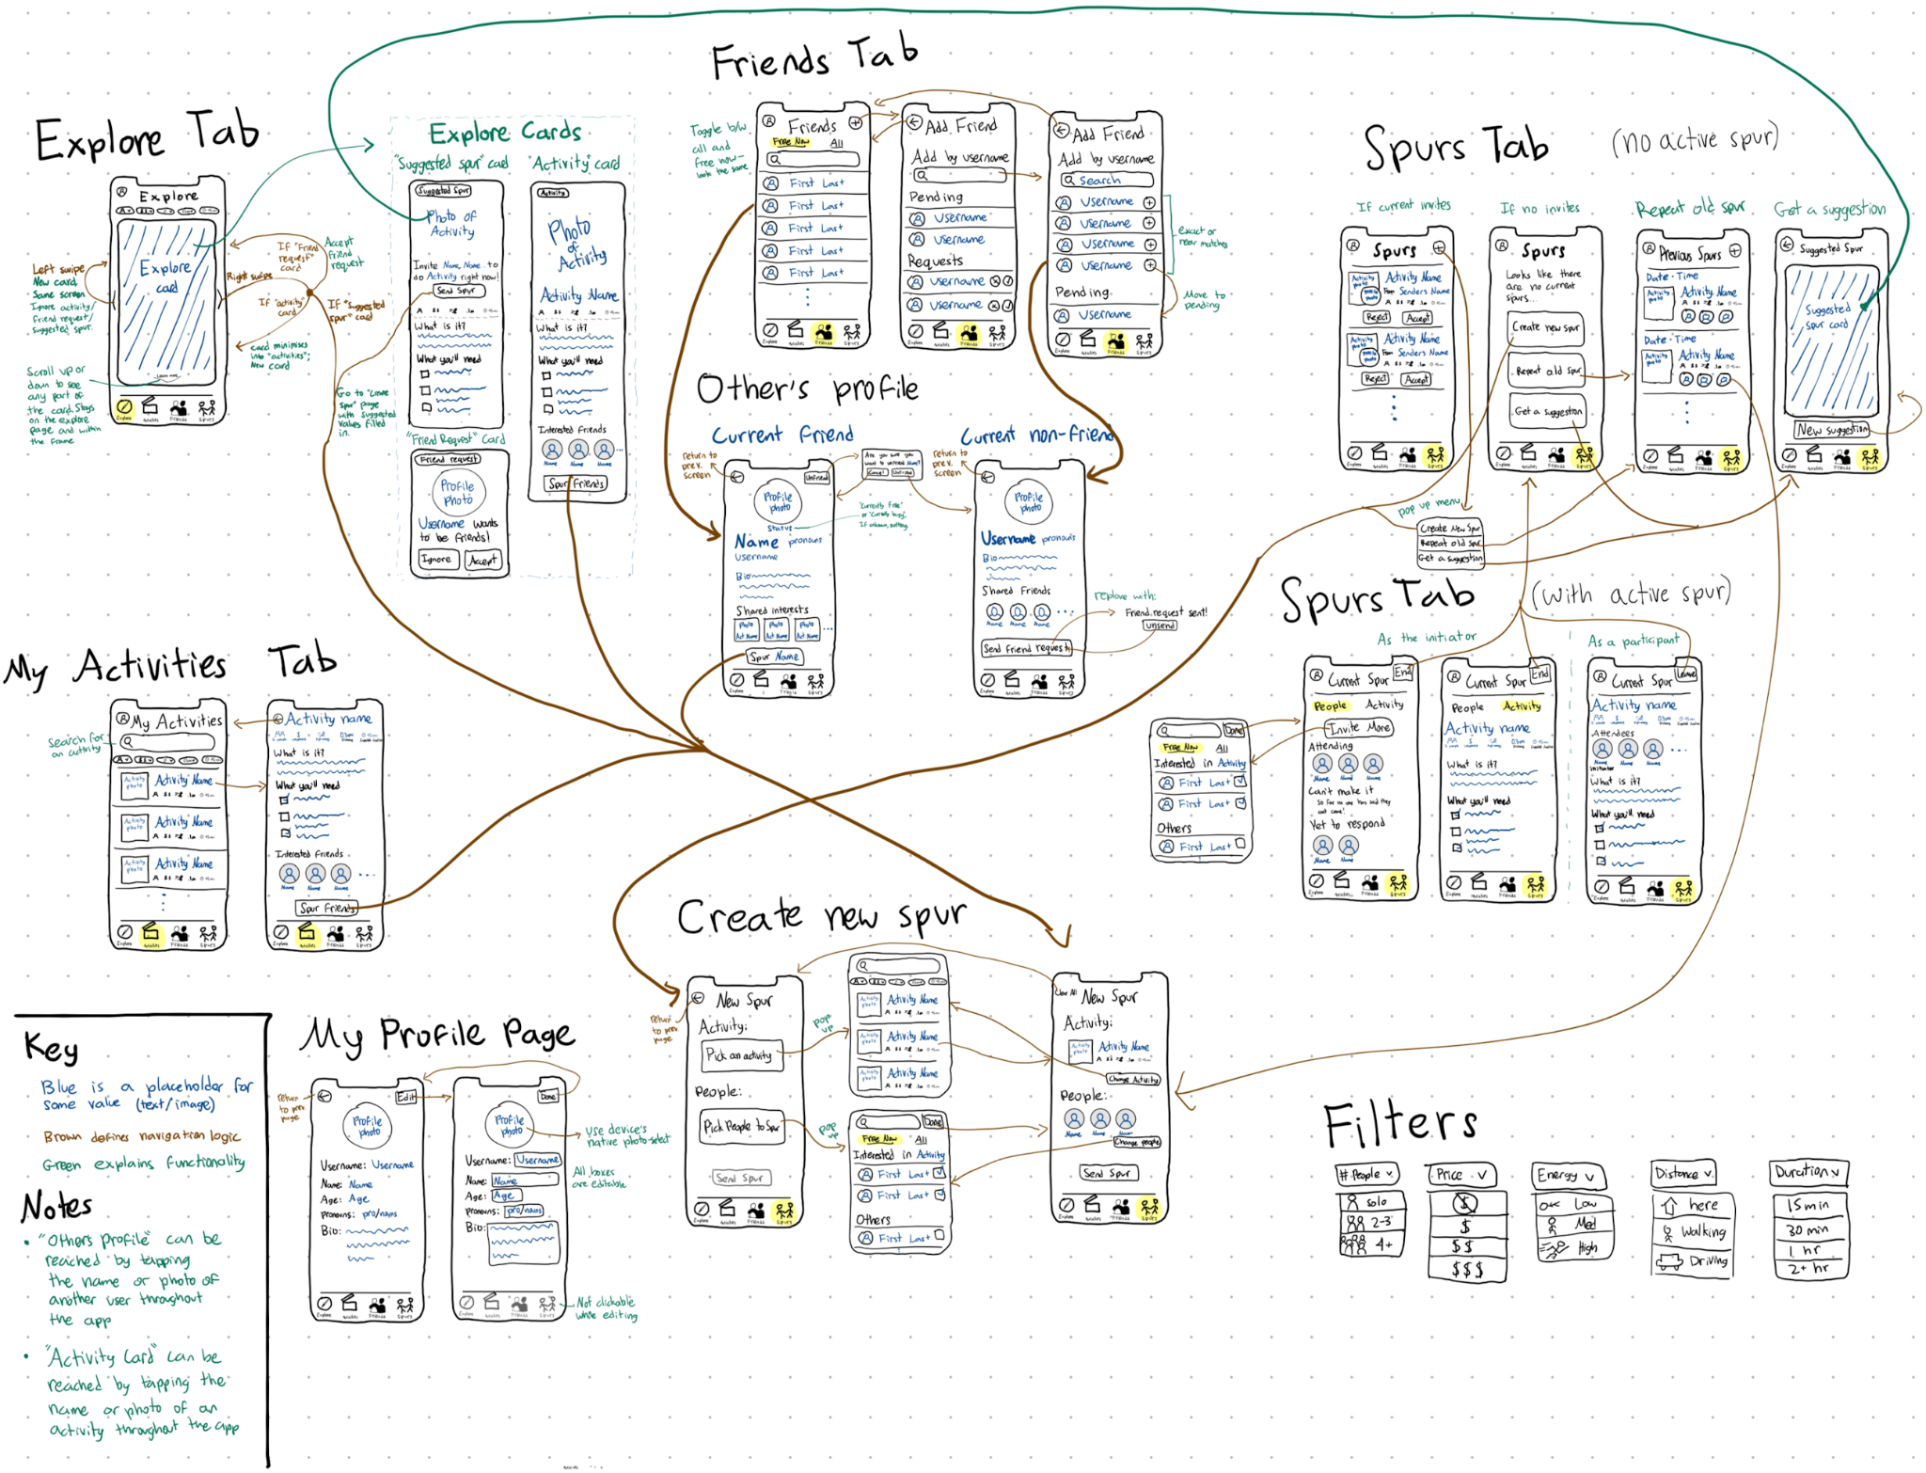
Revised Wireframe

Slide 16
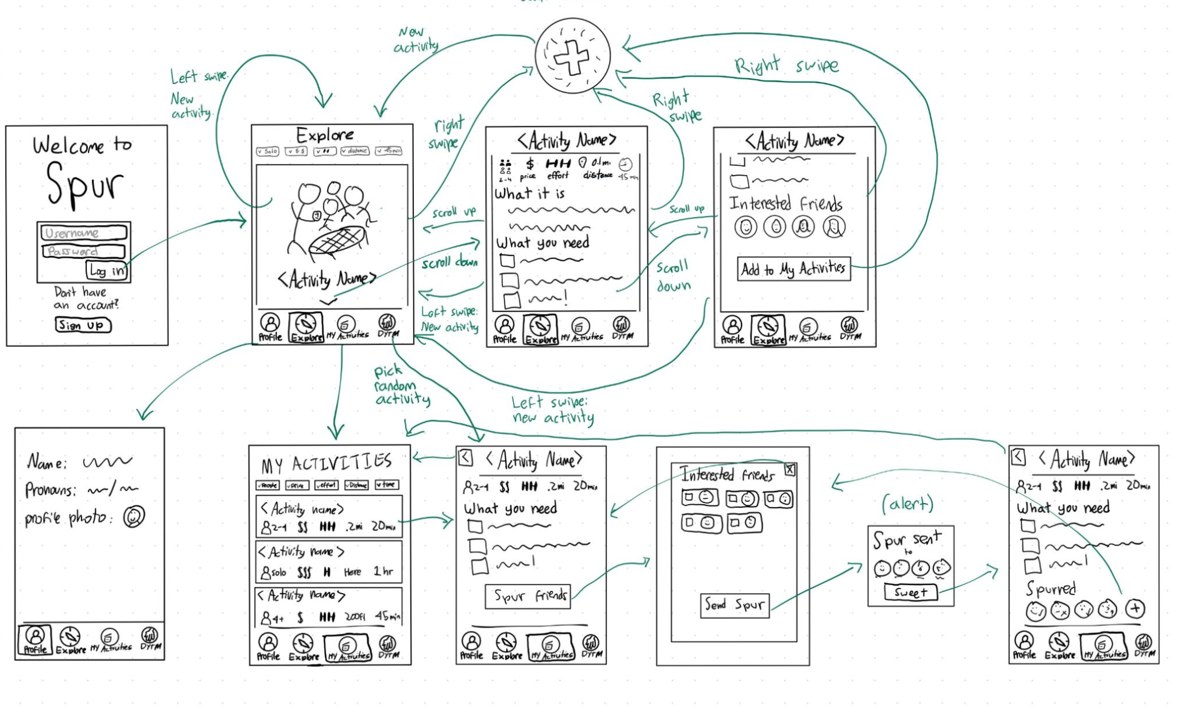
High level comparison…
a lot has changed!
Old
New

Slide 17
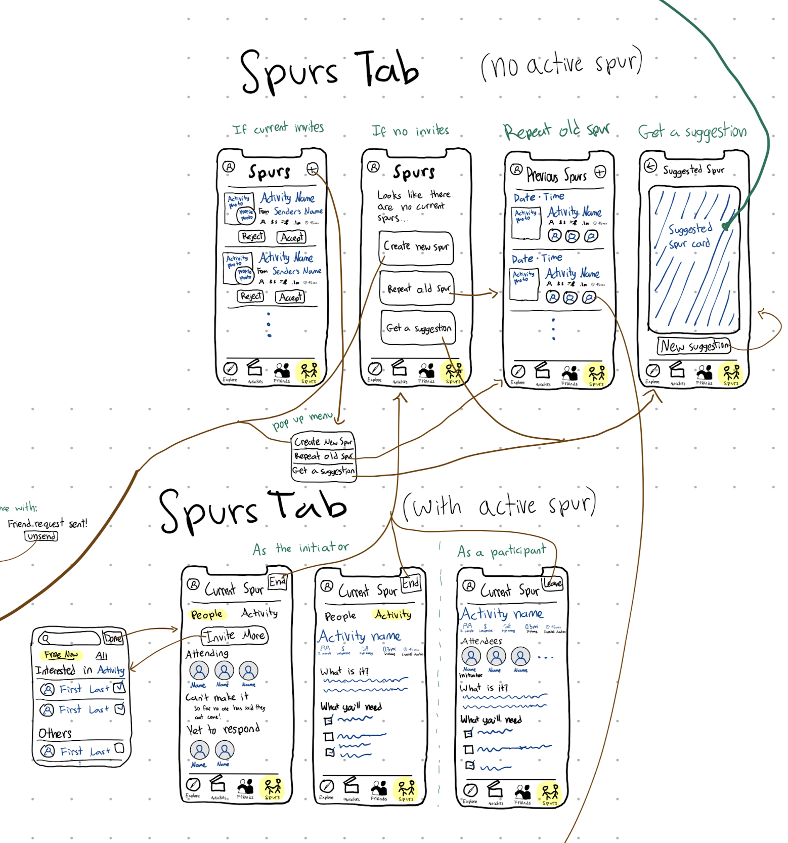
CHANGE 1: Added “Home” TAB
Home Tab (no active spur)
What we changed
Deleted “do you trust me” tab
Created a home tab which serves 2 primary functions:
  If you’re currently committed to an activity, show all of the information to do that activity
  If you aren’t doing an activity, provide options to initiate a spur
Home Tab (with active spur)

Slide 18
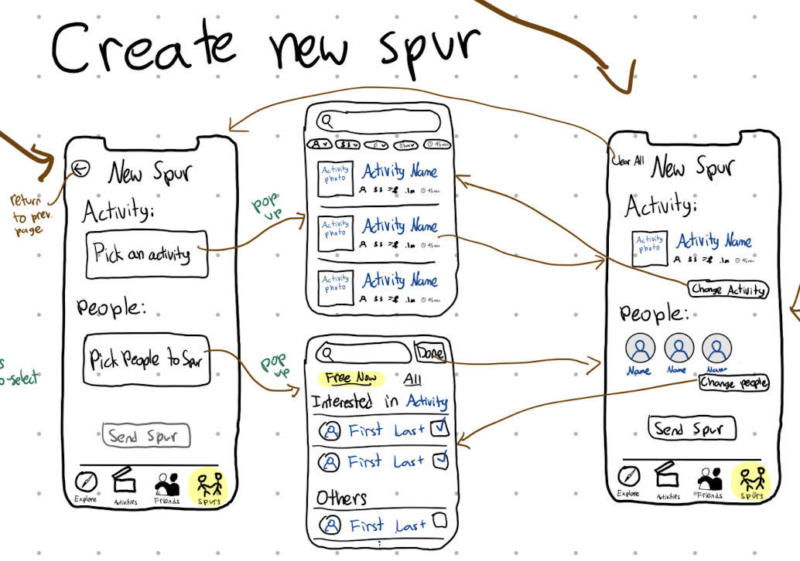
CHANGE 1: Added “Home” TAB
Home Tab (no active spur)
Why we changed it
All users were confused by the “do you trust me” button
Navigating to see the active spur was through the activities page which wasn’t as intuitive
Clarify what it looks like from the side of the person doing the spur
Home Tab (with active spur)

Slide 19
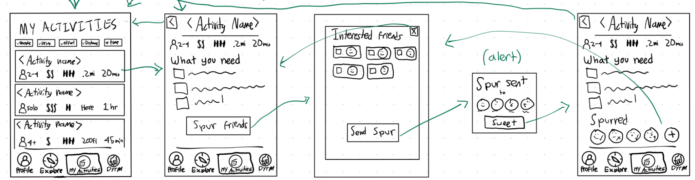
CHANGE 1: Added “Home” TAB
Home Tab (no active spur)
Comparison
Much more flexibility with different ways to initiate the spur
Clearer way to see the current activity
Home Tab (with active spur)

Slide 20
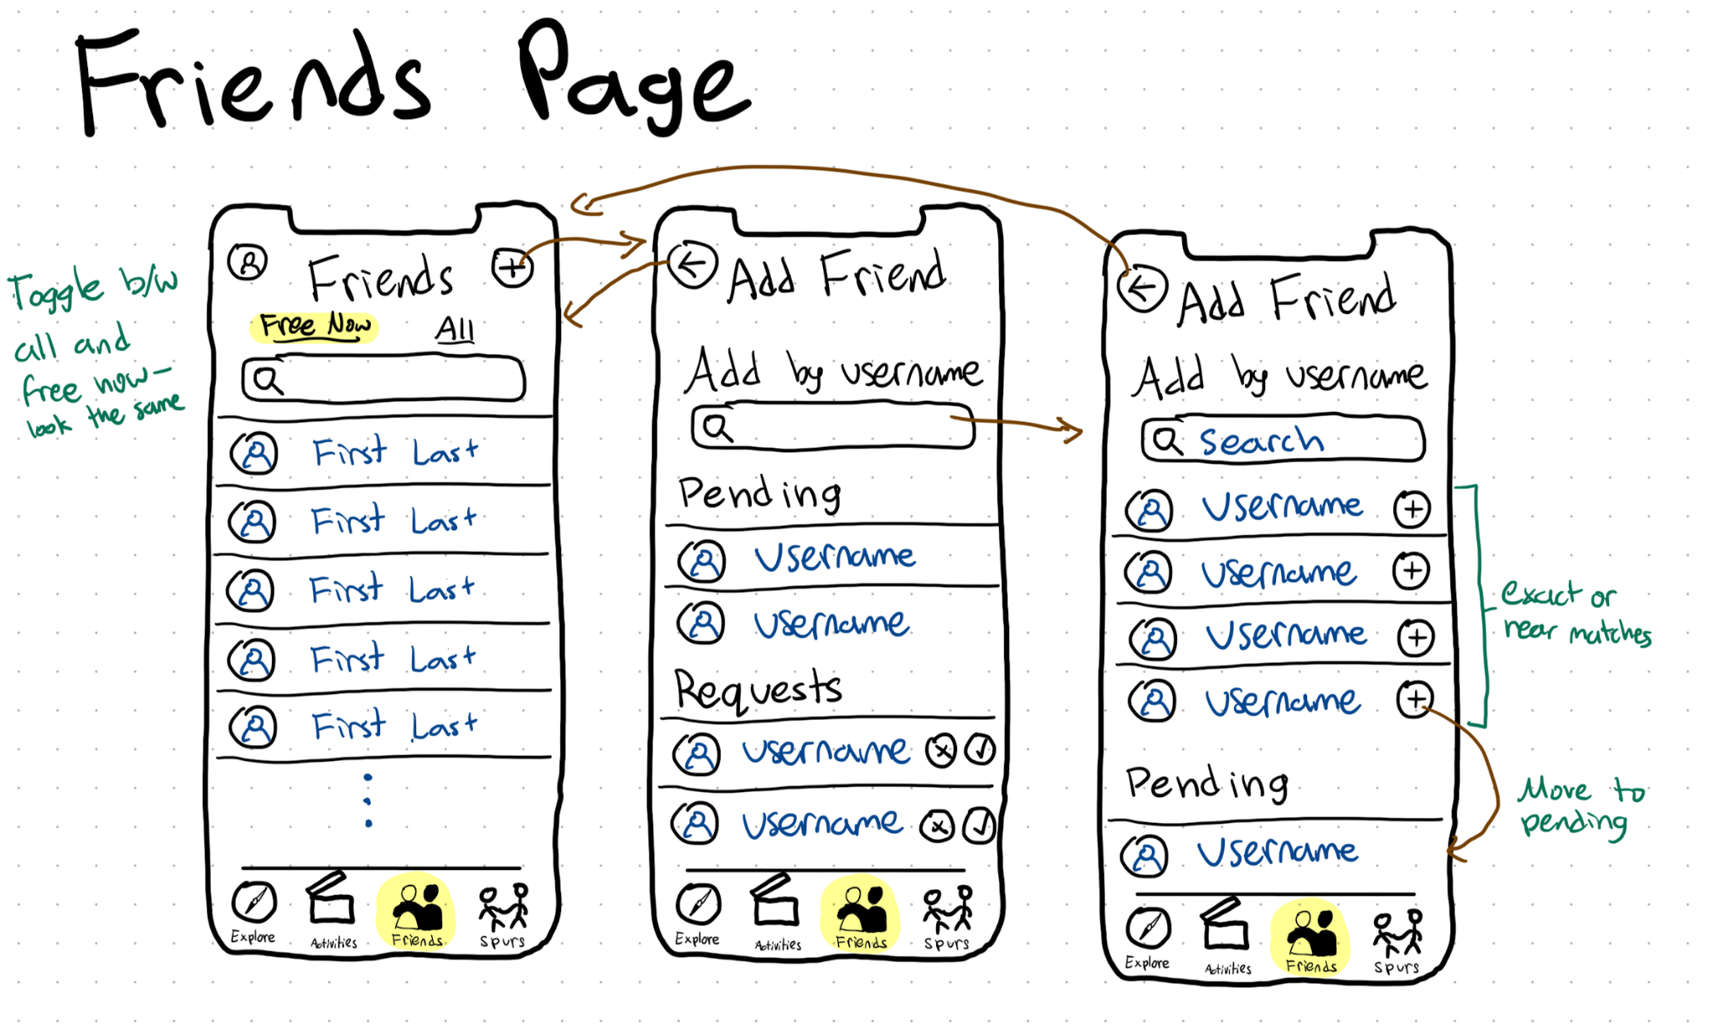
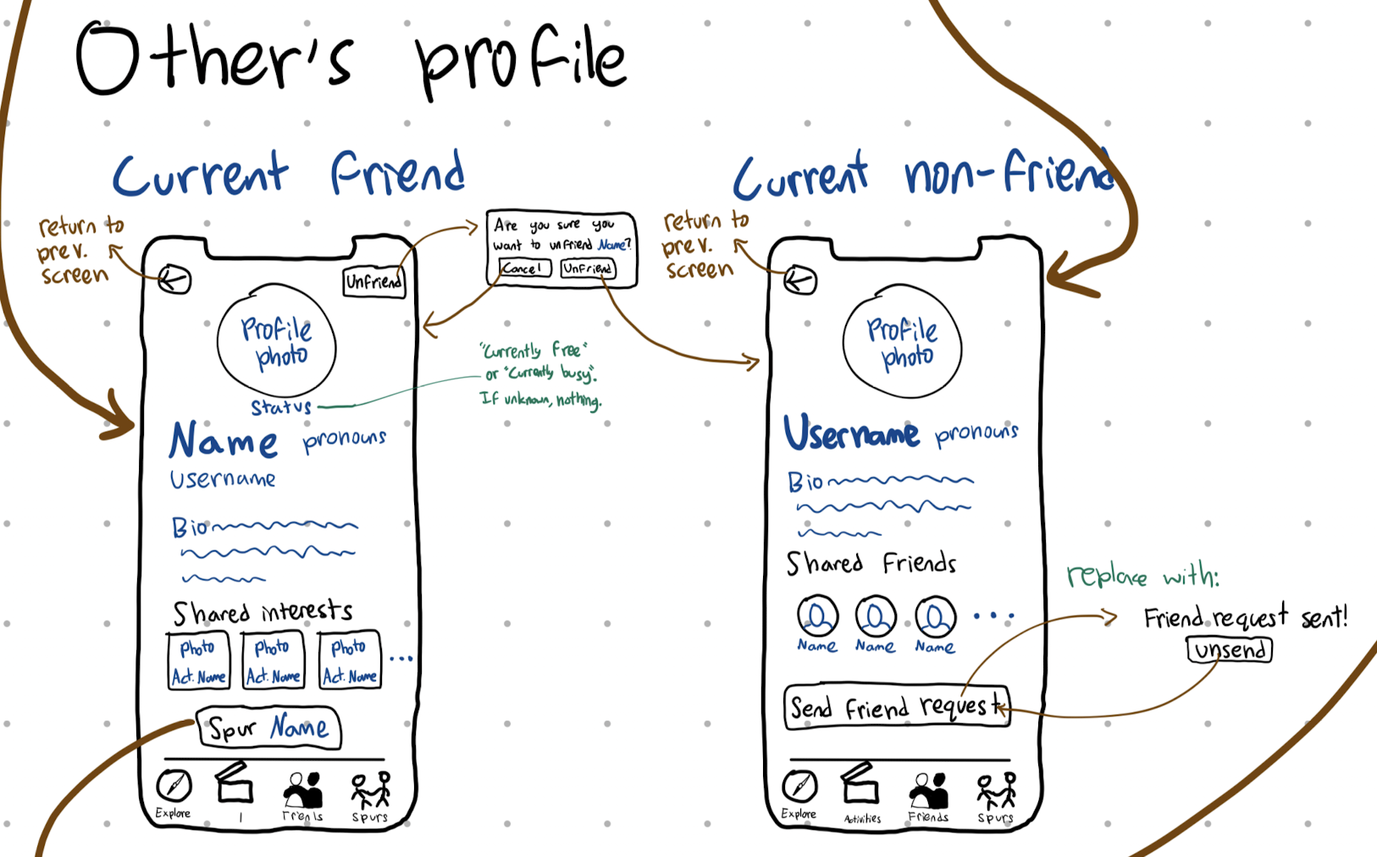
CHANGE 2: NEW “FRIENDS” TAB
What we changed
Added a centralized list of friends
Added the ability to see which friends are free
Added a way to send or accept friend requests
Added a way to learn more about a specific friend

Slide 21
CHANGE 2: NEW “FRIENDS” TAB
Why we changed it
Testers wanted to see a list of their friends
Testers wanted to see more information about a specific friends
Testers wanted to initiate an activity starting by picking a friend (instead of starting from an activity)

Slide 22
CHANGE 2: NEW “FRIENDS” TAB
Comparison
Hard to compare because it’s completely new! But…
More transparent about who your friends are
More intuitive for how to manage friends
Increased flexibility for exploring friends.

Slide 23
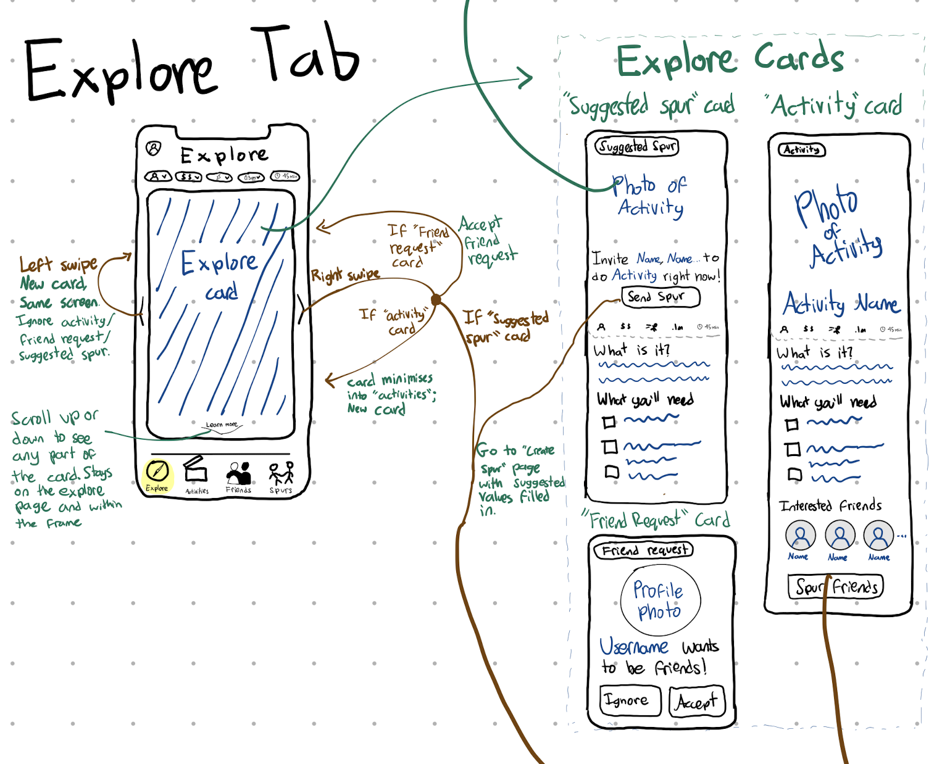
CHANGE 3: NEW “Suggested Spur” Card
What we changed
Added a new type of card to swipe on: “Suggested spur”
  Based off of the users liked activities and the liked activities of their free friends, suggest something to do right now.

Slide 24
CHANGE 3: NEW “Suggested Spur” Card
Why we changed it
We received many notes cautioning that the swiping could become addictive, leading to people never actually acting on them
This helps spur the user into action, as opposed to just letting them swipe forever

Slide 25
CHANGE 3: NEW “Suggested Spur” Card
Comparison
Provides a lot more encouragement to actually get off the phone and do an activity

Slide 26
05
Task Flows

Slide 27
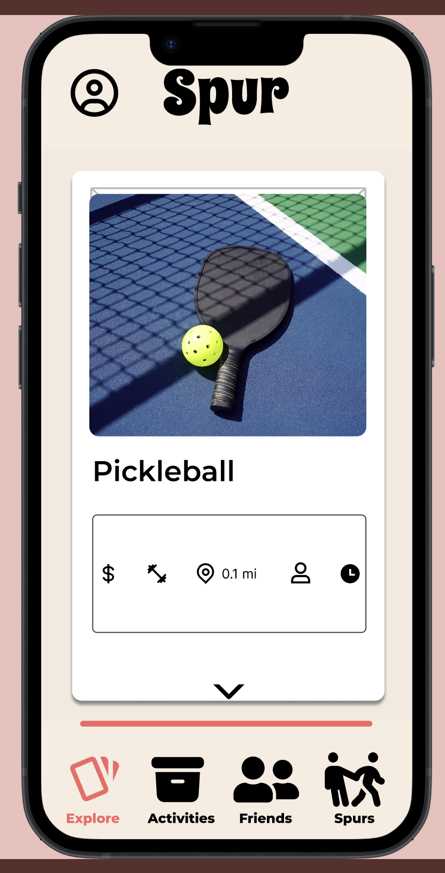
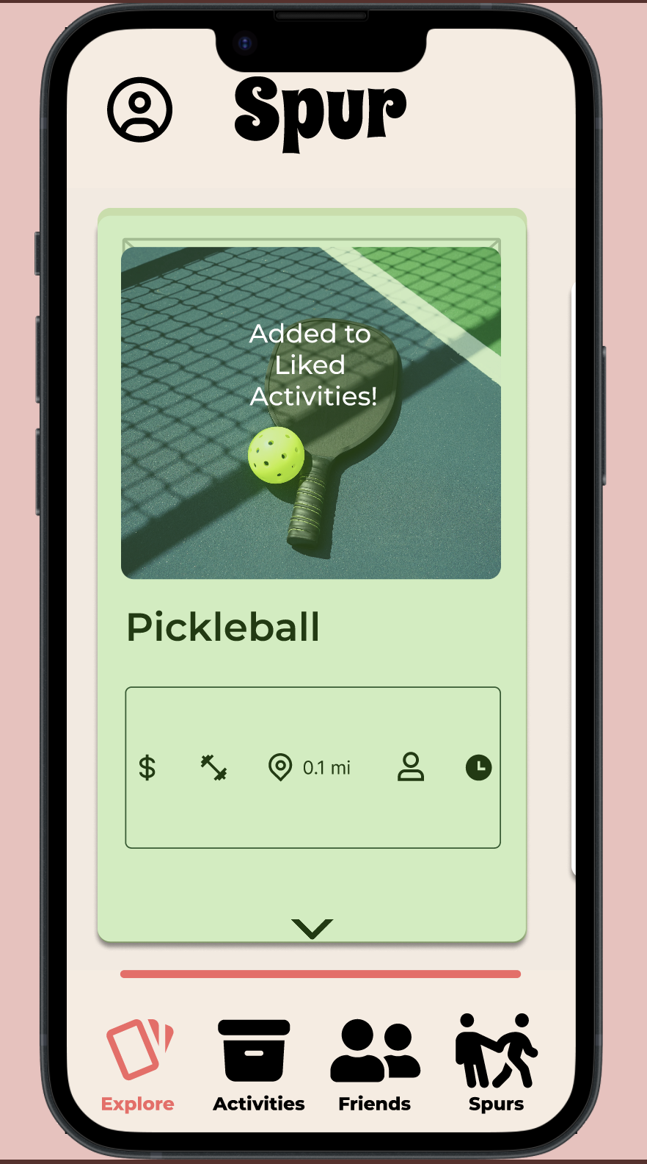
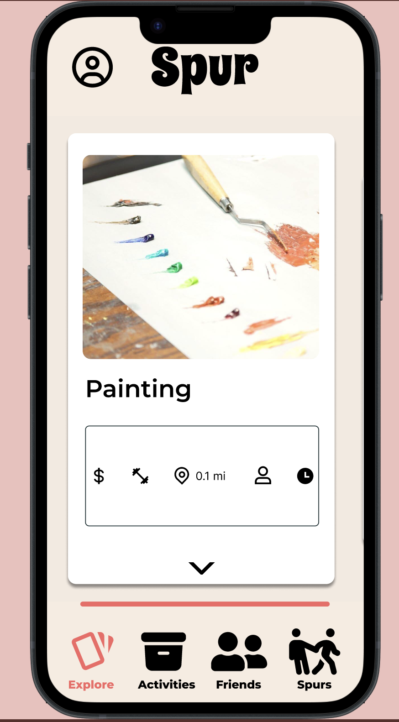
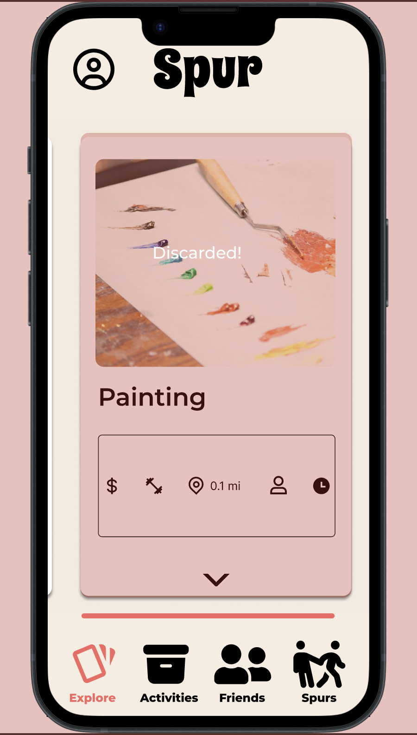
Simple: Find an interesting activity
Right Swipe
Left Swipe

Slide 28
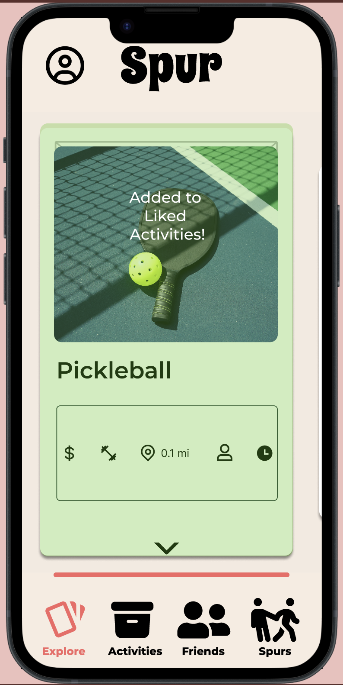
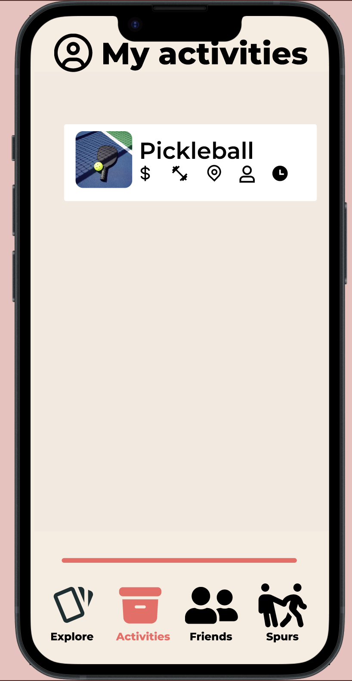
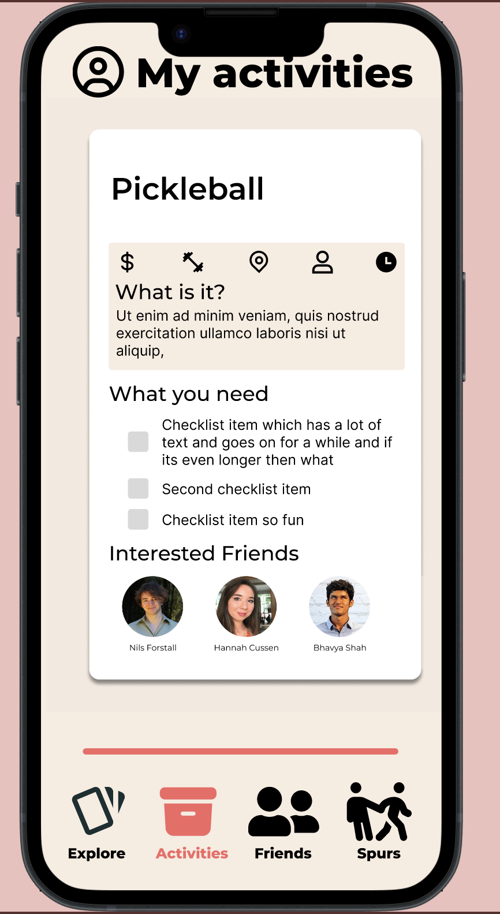
Medium: LEarn more about an act

Slide 29
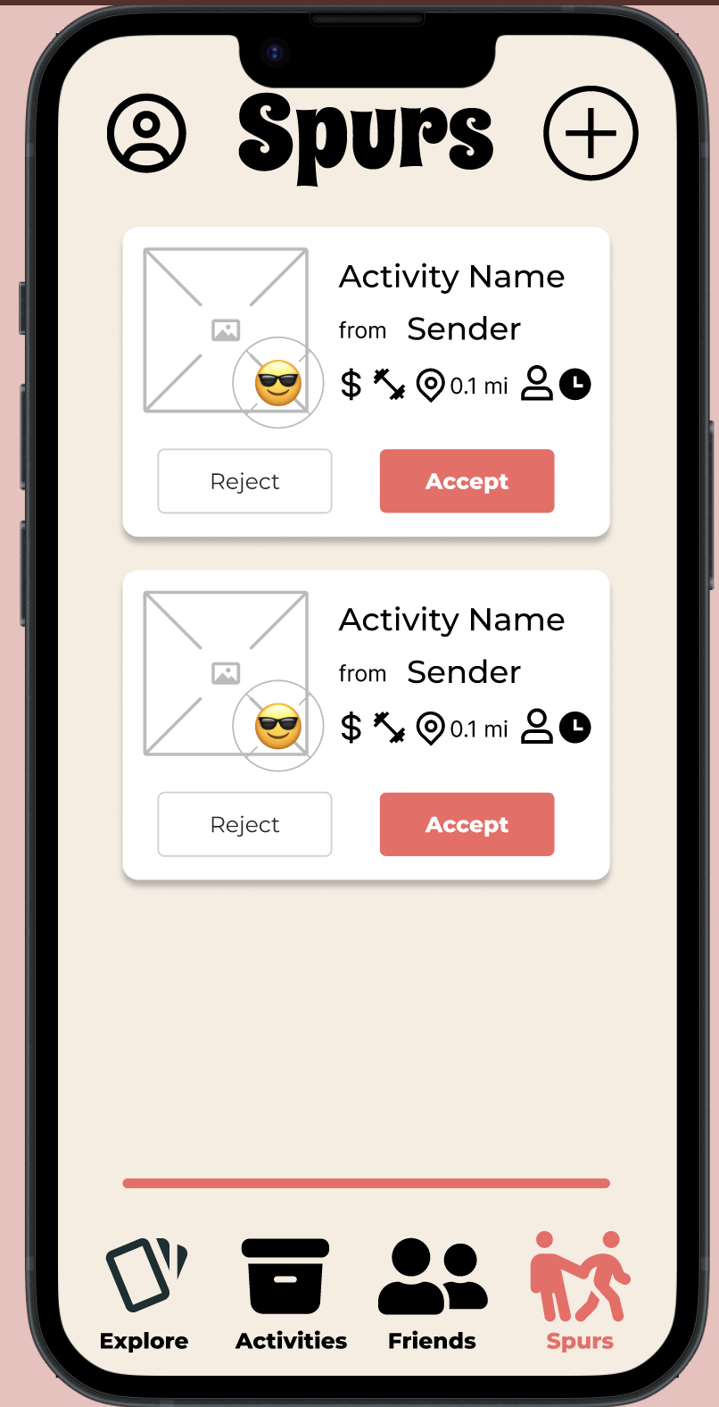
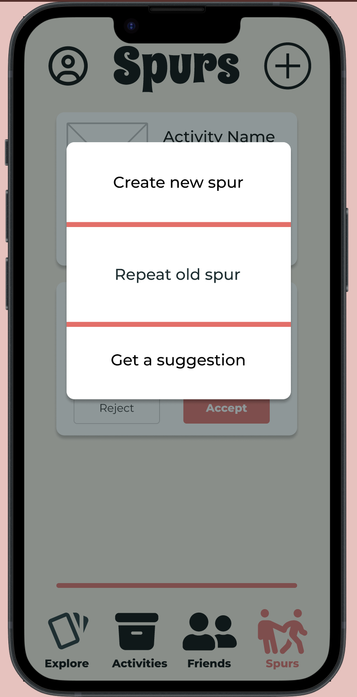
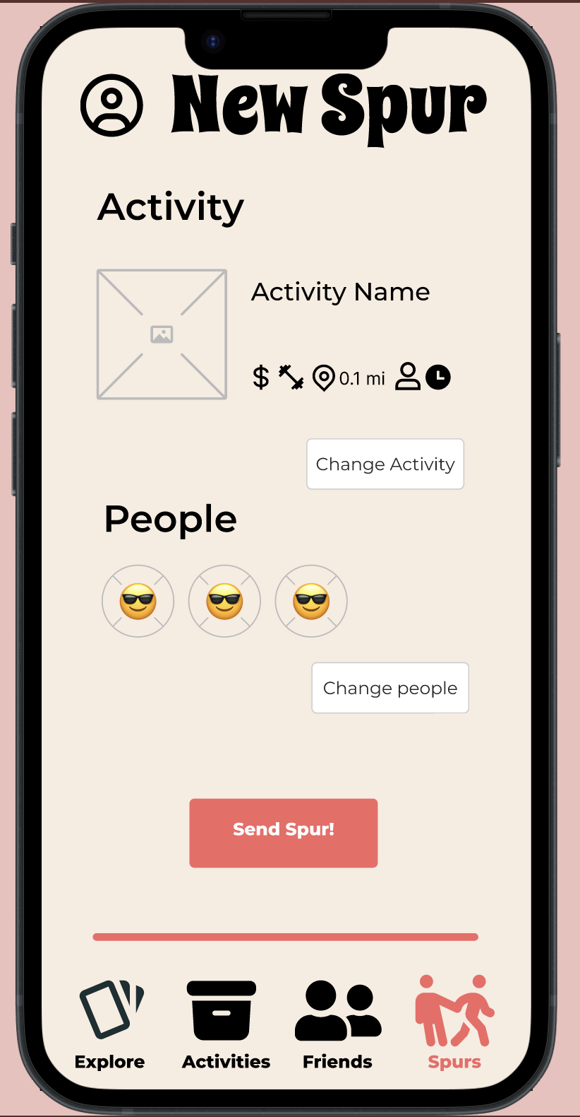
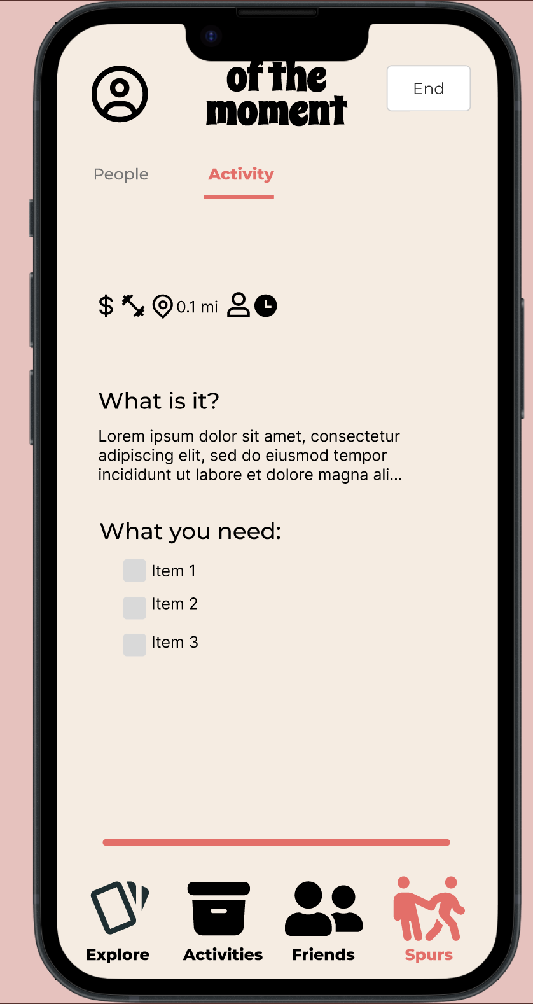
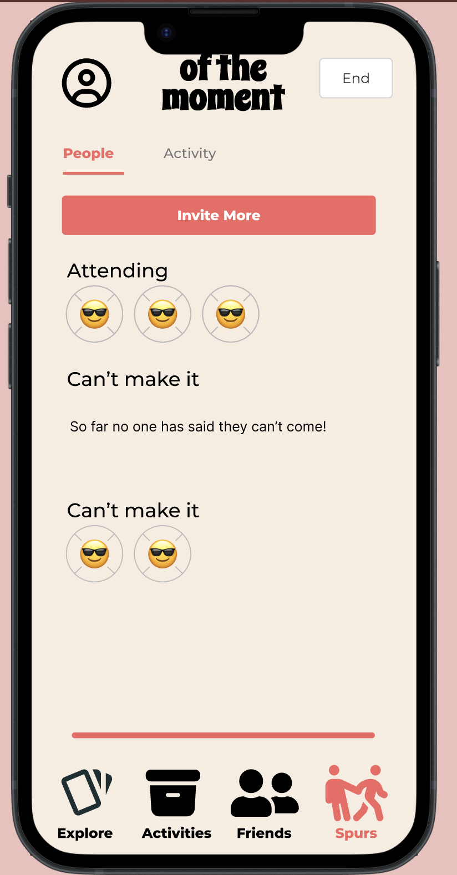
Complex: Coordinate an Activity

Slide 30
06
Prototype Implementation
01

Slide 31
Tools used
Figma
Pros
  Collaborative workflow
  Powerful tool with lots of capabilities
  Popular with lots of support
Cons
  Too much functionality?
    Tricky to get started for a team of all beginners
  Hard to work with variables
The Noun Project
Pros
  Lots of options
  Clear and representative icons
Cons
  Some inconsistencies across icon style

Slide 32
PRototype limitations
Limitations
Elements not implemented since they aren’t directly part of a task flow:
  Profile
  Add friends
  Suggested spur card
Search bars not active
Filters not active
Limited number of activities to swipe through
Hardcoded
Friends + friends information
Activities + activities information
Wizard-of-Oz
Friends + friends information
Activities + activities information

Slide 33

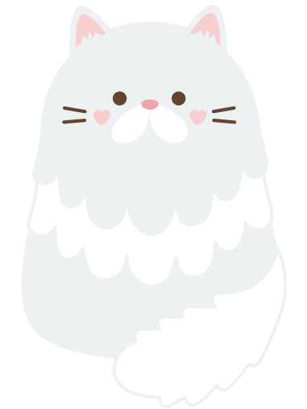
07
Appendix
01

Slide 34

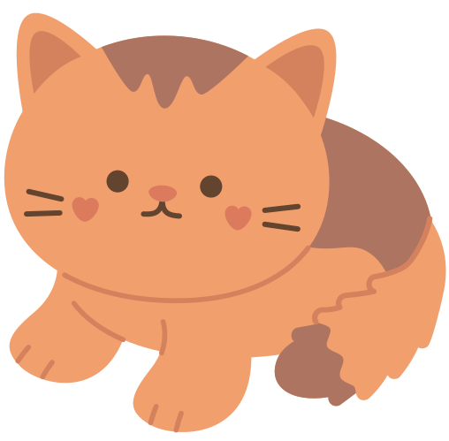
The Prototype
Link
01

Slide 35
More wireframe changes
01

Slide 36
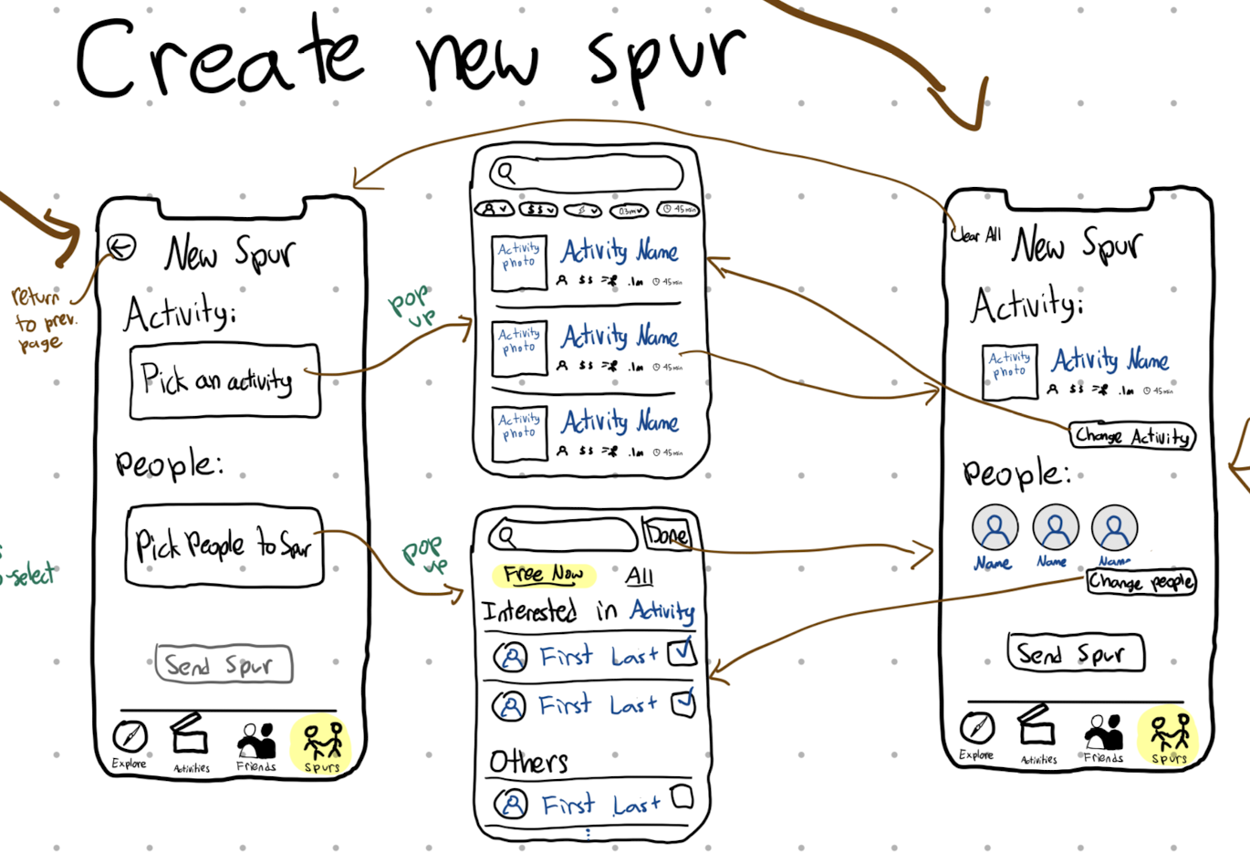
Extra CHANGE 1: “New spurs” Flow
New
What we changed
Before we were only able to invite friends after first selecting the activity. Now you can chose to pick the people or activity first.
User can spur friends who aren’t necessarily interested in the activity
User change activity or participants before sending spur
Old

Slide 37
Extra CHANGE 1: “New spurs” Flow
New
Why we changed it
One participant joked they saw someone on the list they didn’t want to invite, but had no way to remove them.
Old

Slide 38
Extra CHANGE 1: “New spurs” Flow
New
Comparison
Easier to “undo”
More flexible way to invite people
Old

Slide 39



Credits
  This presentation template is free for everyone to use thanks to the following:
  SlidesCarnival
  for the presentation template
  Pexels
  for the photos
Happy designing

